Slide 1
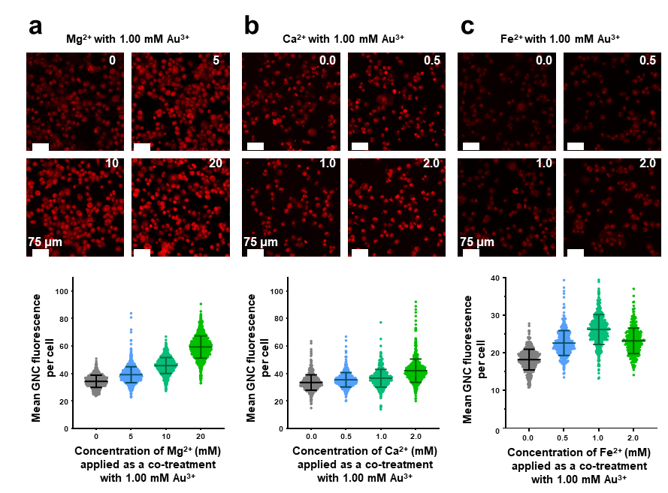
Fig. 1 Metal competition study, indicating that co-applications of metal cations will result in a concentration dependent change in the fluorescence from gold nanoclusters formed from Au3+ treatments
Notes:
PANC1 cells
From ACS Nano

Slide 2
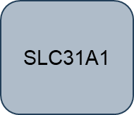
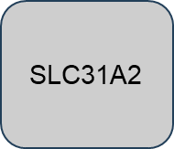

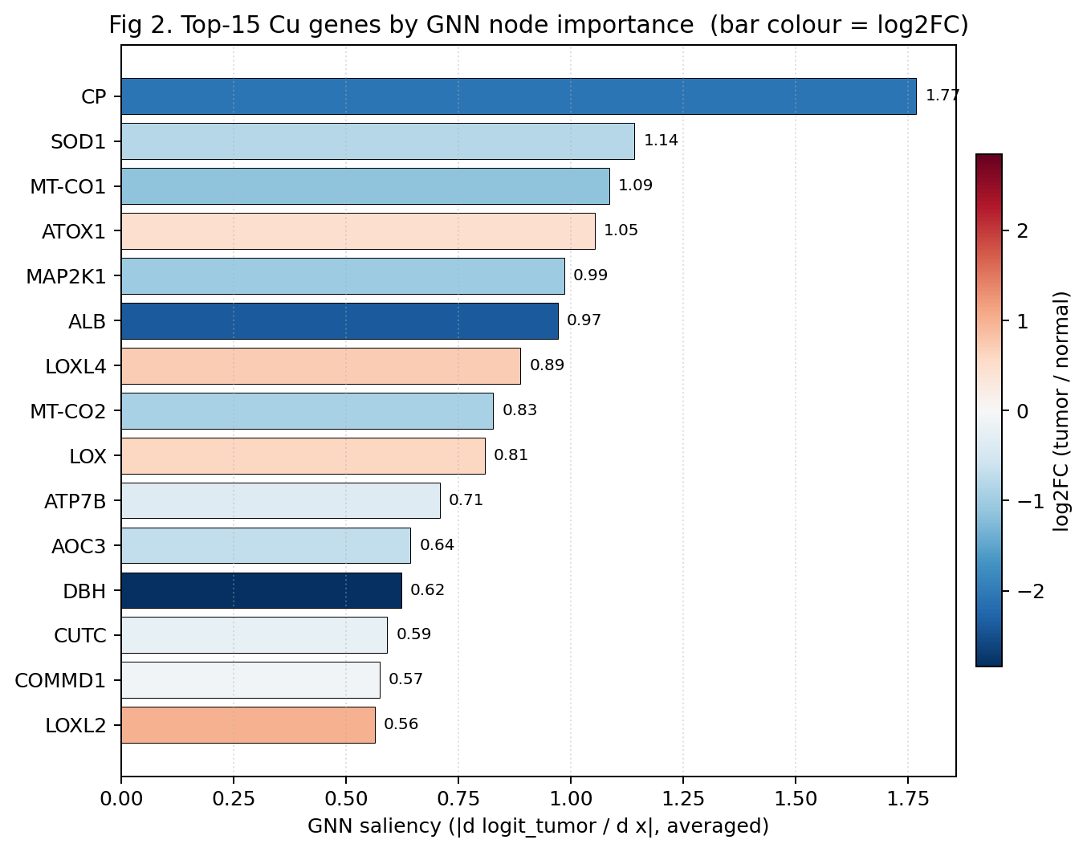
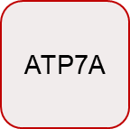

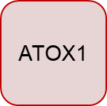
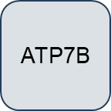

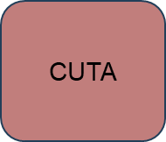
ATP7A
ATOX1
SLC31A2
CUTA
Fig. 1 Top Cu Gene changes along with pathway mapping onto cellular architecture

Slide 3
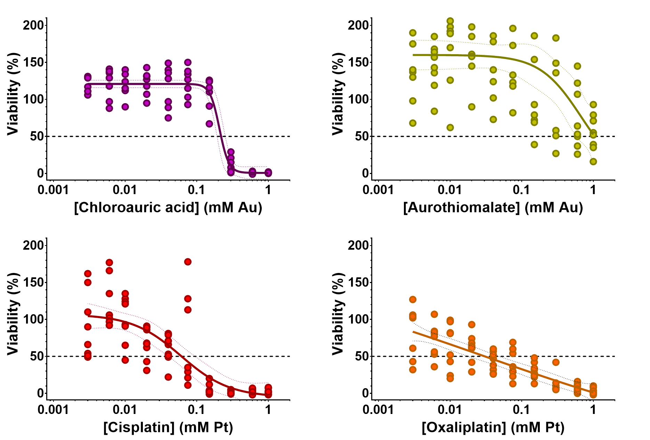
Fig. 3 Comparative cytotoxicity of gold and platinum-based drugs against a liver met cell line
Notes:
This is cytotoxicity against a liver mets cell line. Reviewers always complain that the

Slide 4
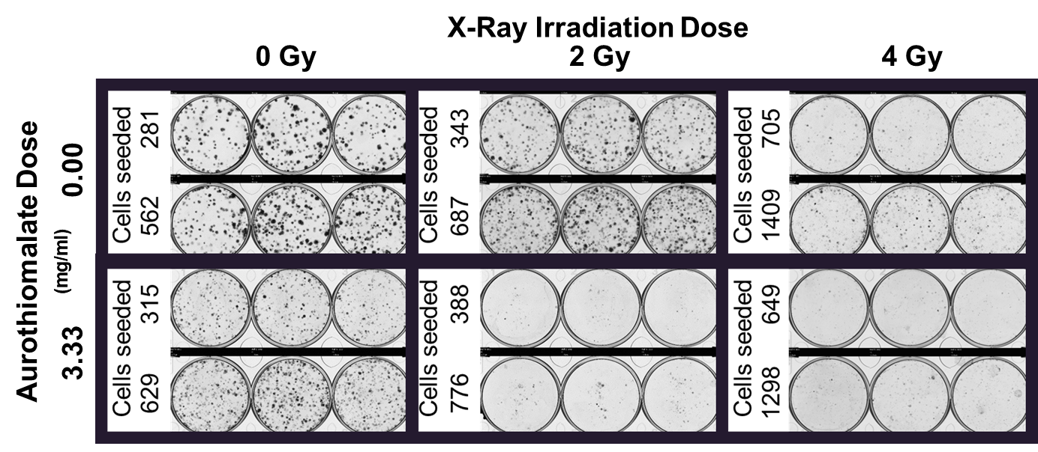
Fig. 4 Radiosensitization of the liver met cell line
Notes:
Example a clinical aurothiomalate dosing (25-50 mg/ml):
- 10 mg IM the 1st wk,
- 25 mg IM the 2nd wk, then
25-50 mg IM qWk x 20 wk until 1000 mg cumulative dose https://pubmed.ncbi.nlm.nih.gov/6405834/
https://www.drugs.com/dosage/gold-sodium-thiomalate.html

Slide 5
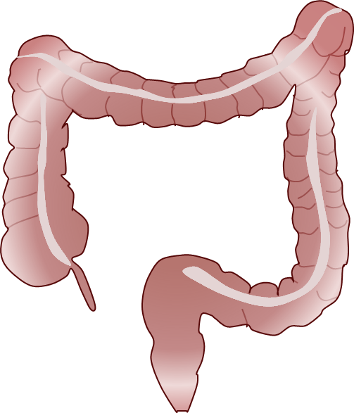

Notes:
Art

Slide 6
Fig. 3 Comparative cytotoxicity of gold drugs against a HCC cell line
Notes:
Data with HepG2 Liver Cancer

Slide 7
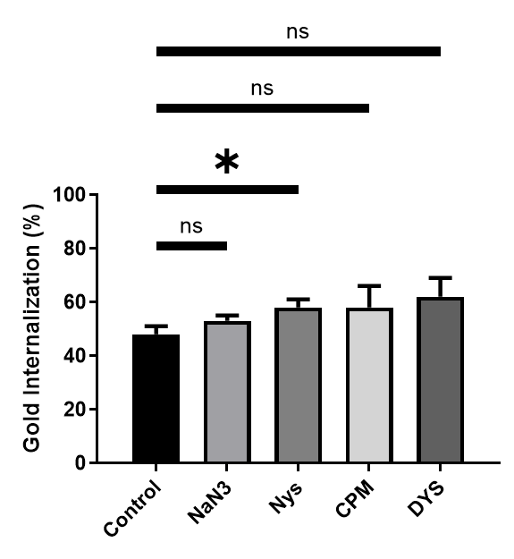
Gold uptake to a breast cancer cell linein the context of different inhibitors for classical nanoparticle uptake pathways
Notes:
With MCF7 breast cancer cells Inhibitior study showing, that inhibition of classic nanoparticle pathways do not inhibit intracellular GNC synthesis

Slide 8
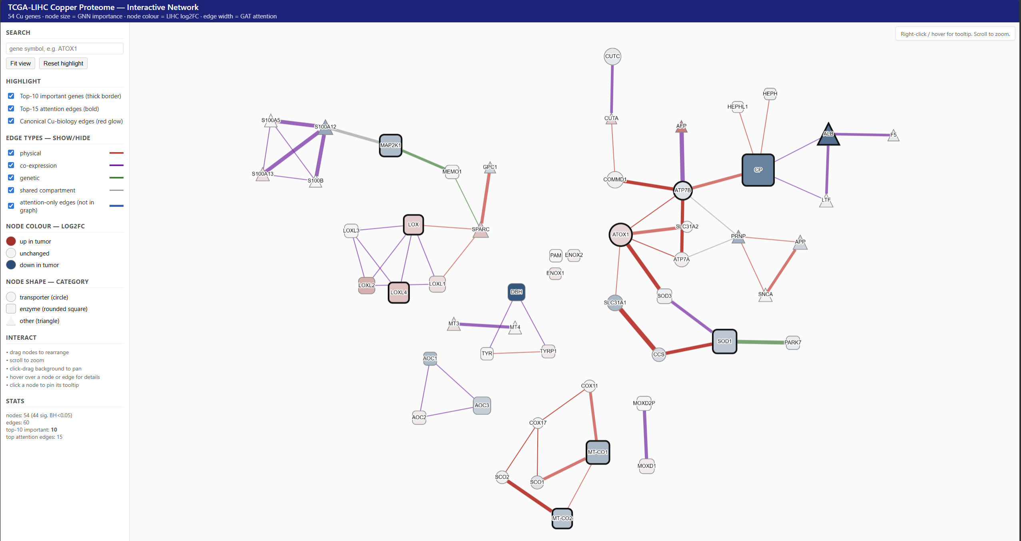
ATP7A
ATOX1
SLC31A2
CUTA

